Slide 1

SFWRENG 4HC3 6HC3 /COMPSCI 4HC3 Human Computer Interfaces Lab 2: Design Thinking
SFWRENG 4HC3 6HC3 | COMPSCI 4HC3 Danny Papagiannis
Acknowledgement: Parts of these lectures are based on material prepared by 3M, Andrew Maxwell, IDEO, and open source material from the Internet

Slide 2
WELCOME TO THE KICKOFF FOR THE 2021 DESIGN PROJECT!

Slide 3

Design Theme: Safety on Campus
https://ugdsbisp.com/wp-content/uploads/2017/01/McMaster-University.jpg
https://ugdsbisp.com/wp-content/uploads/2017/01/McMaster-University.jpg

Slide 4

Problem Solving With The A-Team
https://images2.minutemediacdn.com/image/upload/c_crop,h_358,w_640,x_0,y_12/f_auto,q_auto,w_1100/v1555924029/shape/mentalfloss/a-team_1.jpg

Slide 5
A-Team: Breakout Session
4 former US Special Forces soldiers who are framed for a crime they did not commit
Fugitives who are running from the law and helping people
Intro video: https://www.youtube.com/watch?v=_MVonyVSQoM
1. How does the A-Team get out of the room?
2. How does the A-Team get the bad guys?
6 mins

Slide 6
A-Team
How did the A-Team get out of the locked room?
If identified getting out of a locked door as the problem, then you identified the wrong problem

Slide 7

Welcome to Design Thinking!
https://www.google.com/url?sa=i&url=https%3A%2F%2Ftimoelliott.com%2Fblog%2F2014%2F02%2Fcartoon-design-thinking.html&psig=AOvVaw20PPnbBoh7bxB-9v5BLm7R&ust=1632352596953000&source=images&cd=vfe&ved=0CAsQjRxqFwoTCICsz8eZkfMCFQAAAAAdAAAAABAD

Slide 8
What is Design Thinking:
IDEO
Design thinking is a process for creative problem solving
Design thinking has a human-centered core
Design thinking is a human-centered approach to innovation—anchored in understanding customer’s needs, rapid prototyping, and generating creative ideas—that will transform the way you develop products, services, processes, and organizations.

Slide 9
What is Design Thinking?
Professor’s Notes
A way of seeing, thinking, and perceiving
Consider the tasks that the user is trying to do
What is the job that they are trying to do?

Slide 10
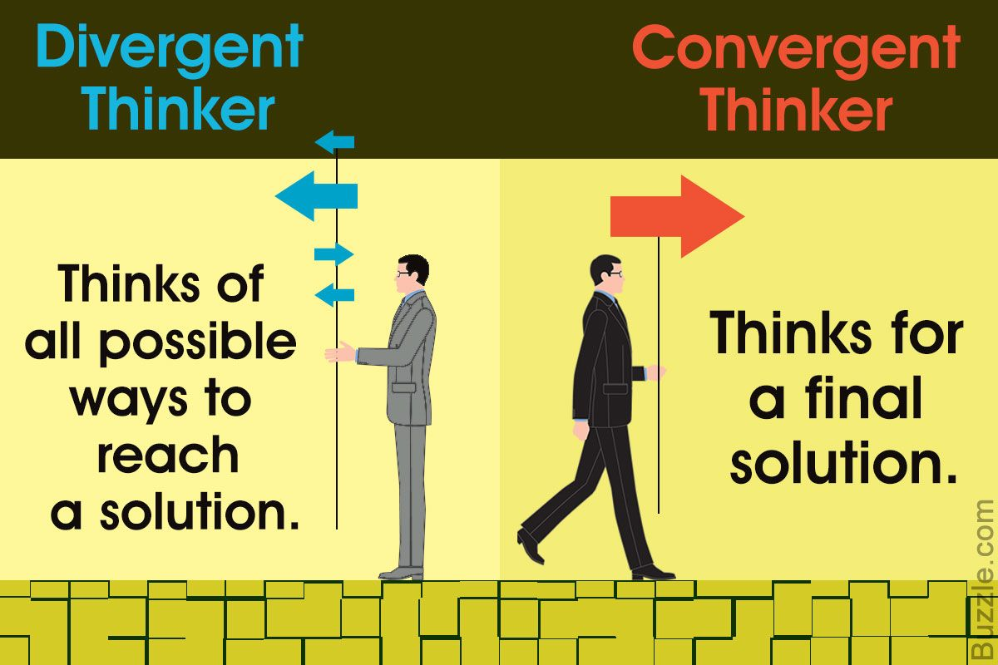
Divergent Thinking
https://i.pinimg.com/originals/d0/71/47/d07147d19e52c74ab1892de74973dab0.jpg

Slide 11
Divergent vs Convergent
Divergent Thinking
Brainstorming
Convergent Thinking
Making a decision

Slide 12
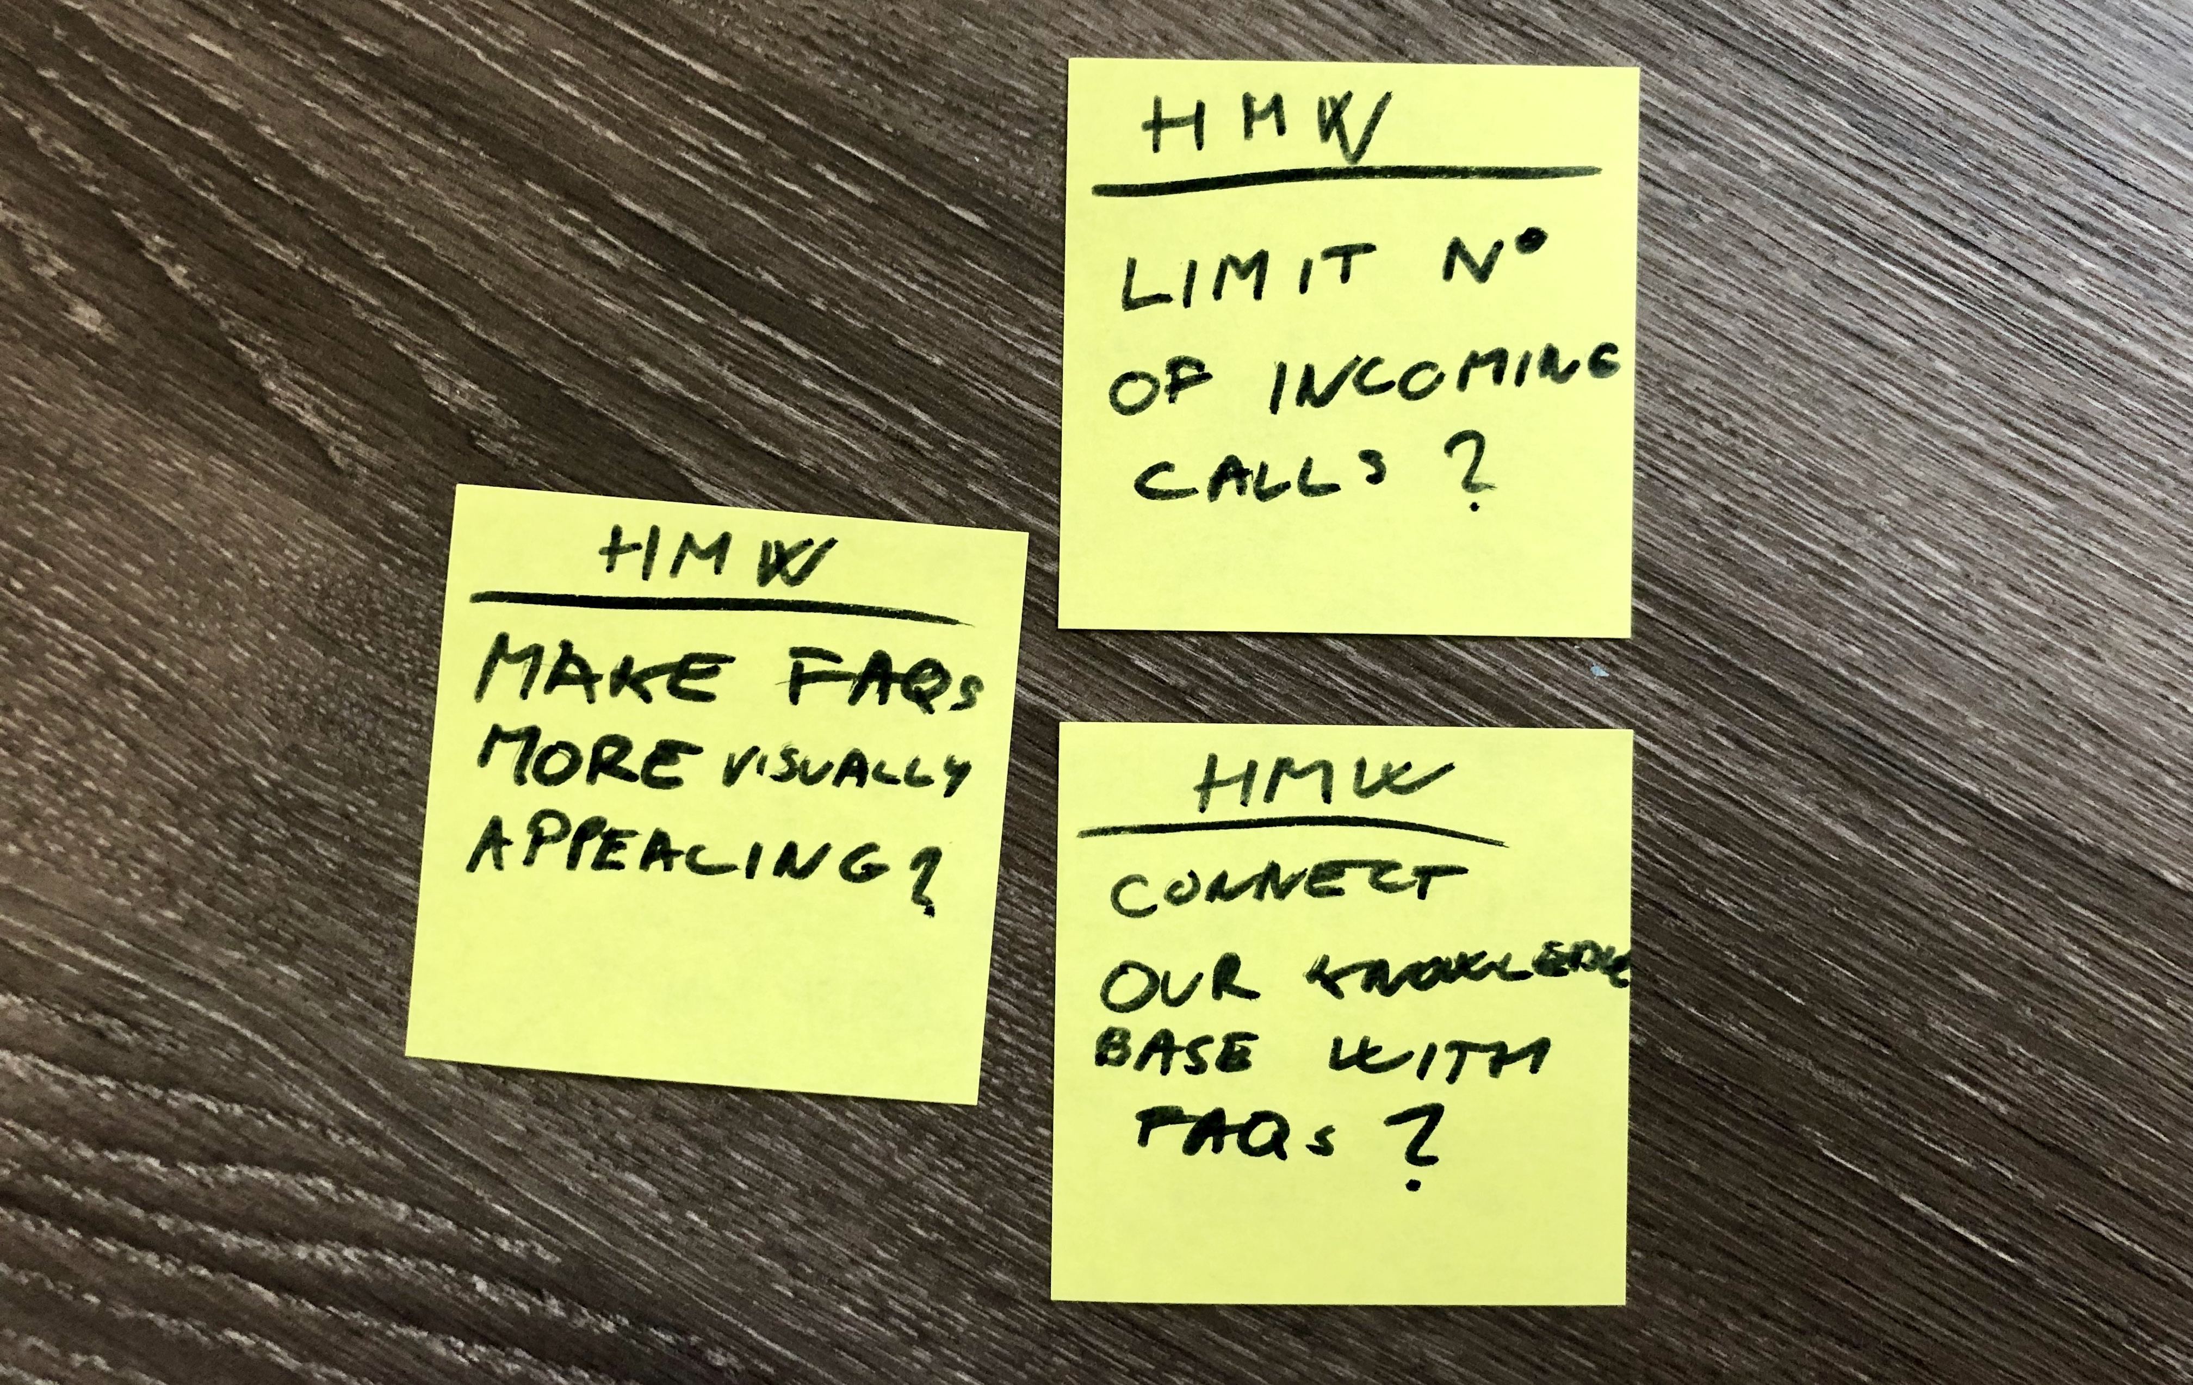
How Might We (HMW)
https://www.google.com/url?sa=i&url=https%3A%2F%2Fpdmethods.com%2Fhow-might-we-questions%2F&psig=AOvVaw1_yeCoD1Cx8RNGfGFhviwh&ust=1632353454620000&source=images&cd=vfe&ved=0CAsQjRxqFwoTCNC6sdackfMCFQAAAAAdAAAAABAD

Slide 13
HMW
Rephrase a problem as a question in the form of How Might We - simple
Look for opportunities not solutions
Try not to be too broad or too specific
But just do it!!!
Don’t worry about being perfect

Slide 14
HMW
HMW we use location to show relevant results?
How might we design a product that makes our users feel confident and secure during their online financial transactions?

Slide 15
HMW -Diverge (10 mins)
1. Random groups of 5 individuals
2. Assign 2 people two speakers and 3 writers
The 2 speakers will speak openly about safety on campus – any problems or concerns that they have
3 The writers will take notes in the form of HMW questions – what problems or opportunities do you see?

Slide 16
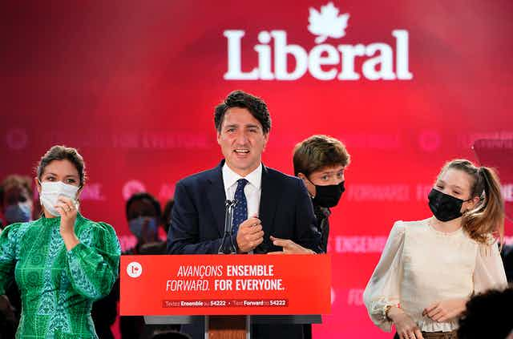
VOTE
https://images.theconversation.com/files/422302/original/file-20210921-21-1deoiqh.jpg?ixlib=rb-1.1.0&rect=0%2C4%2C1640%2C1085&q=20&auto=format&w=320&fit=clip&dpr=2&usm=12&cs=strip

Slide 17
HMW – Vote (5 mins)
4. Place your HMW statements on the wall or on a table (or online)
5. Each group member has 3 votes – 3 dots. They can vote for different HMW or even for a single one - silence

Slide 18
HMW – Converge (15 mins)
6. Discuss the results from each HMW that received a vote (10 mins)
7. Decide on a single HMW and present it to the class (5 mins)

Slide 19
HMW
Post your HMW on the discussion board on Avenue
Feel free to use this as the starting point for your term project or to use a different idea (even non-HMW)

Slide 20
Homework
Watch the videos in the Lab 2 folder on Avenue

Slide 21
GOOD LUCK!

